Slide 1

Help! How do I Diagnose and Stage this Lung Cancer?
Henry D. Tazelaar, M.D
Geraldine Colby Zeiler Professor of Cytopathology,
Chair of Laboratory Medicine and Pathology
Mayo Clinic Arizona

Slide 2
Disclosures
Dr. Tazelaar has no relevant disclosures to the topics being presented

Slide 3
Objectives/Outline
At the end of the lecture, participants should be able to
Have an understanding of the current WHO classification for lung adenocarcinoma and how it differs from previous classifications
Should be able to successfully navigate the traps in making a diagnosis of adenocarcinoma on small biopsies
Will know how to report lung cancer in accordance with AJCC 8th edition

Slide 4
Pathologic Classification of Lung Cancer
WHO 2004
Light microscopy
Use of limited special stains e.g mucin
No terminology for small biopsies/cytology
WHO 2015
Light microscopy & Immunohistochemistry
Small specimen guidelines
Personalized therapies
Notes:
Many years ago, a patient would have to undergo surgery to determine what a lung nodule represents—a benign or malignant process.
If the lesion turned out to be lung cancer many years ago, there were only 2 chemotherapy options—a one size fits all approach.
Now he/she can have a fine needle biopsy or core biopsy.
Now there are multiple therapeutic options.
To summarize, many years ago large samples would be obtained and no additional tests would be required to determine the appropriate treatment.
Now, small samples are obtained and multiple tests are required to determine treatment.

Slide 5
Adenocarcinoma Classification in
Resection Specimens
Pre-invasive lesions
Minimally invasive
Invasive
Variants of invasive

Slide 6
Preinvasive Lesions
Atypical adenomatous hyperplasia (AAH)
Adca in situ, AIS ( < 3 cm, former BAC)
Minimally Invasive
< 3 cm lepidic predominant < 5 mm invasion

Slide 7
Invasive Adenocarcinoma
Lepidic predominant
  Former nonmucinous BAC, with > 5 mm invasion
Acinar predominant
Papillary predominant
Micropapillary predominant
Solid predominant

Slide 8
Invasive Adenocarcinoma Variants
Invasive mucinous
  Formerly mucinous BAC
Colloid
Fetal
Enteric

Slide 9

Some Key Points
No more BAC
All invasive tumors are appended with “predominant”
  Implies semiquantitative recording of patterns -- 5% increments
Invasion now identified by pattern as well as by presence of desmoplasia

Slide 10
Diagnostic Categories on
Small Biopsies/Cytology Specimens
Describe morphologic adca patterns present e.g. acinar, lepidic, colloid
Pure lepidic tumor? State invasion cannot be excluded
If ADCA NOT present, should be supported by special stains, e.g. mucin or IHC

Slide 11
Atypical Adenomatous Hyperplasia
Localized small proliferation of
  Mild to moderately atypical cells
  Lining involved alveoli and sometimes respiratory bronchioles…
  Usually less than 5 mm in diameter (not absolute!)
  Double nuclei rare
  Alveolar walls may be thickened
  Pseudopapillae and tufts may be present
  Diagnosis reserved for resection specimens

Slide 12
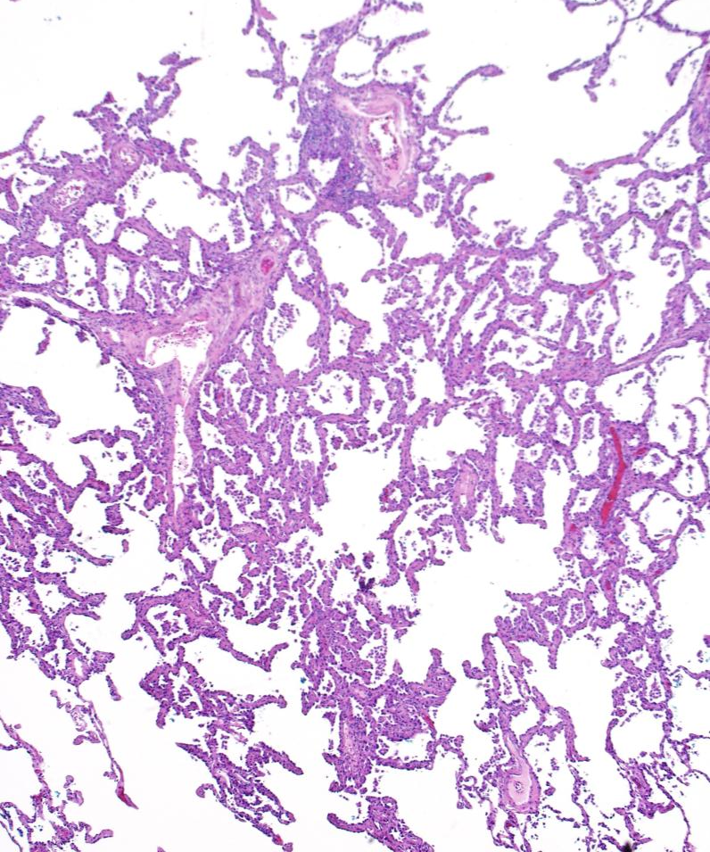
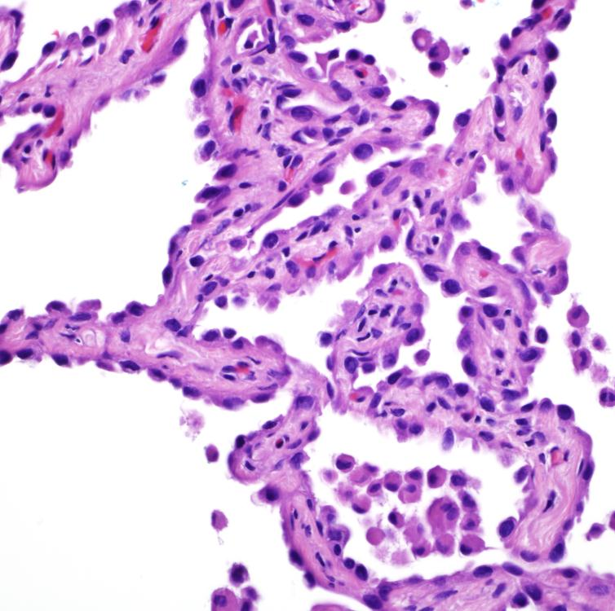
Atypical Adenomatous Hyperplasia

Slide 13
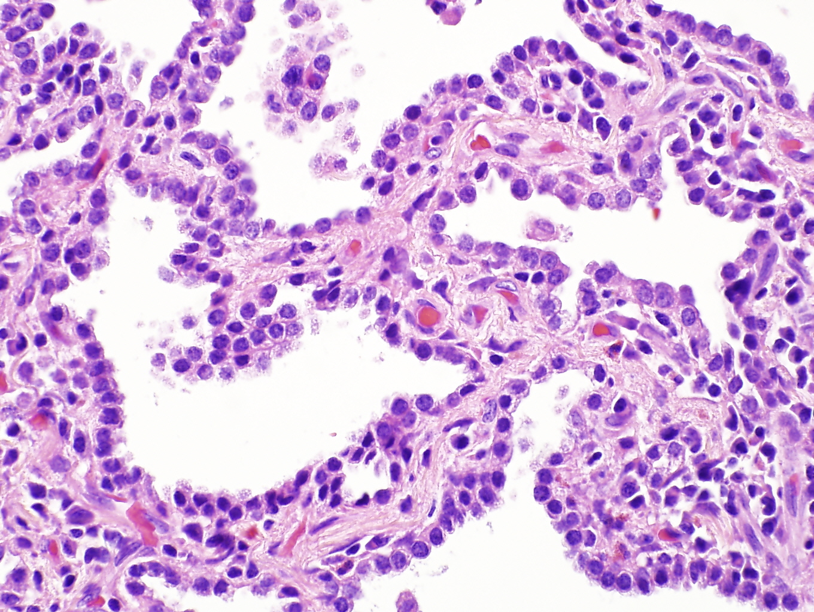
Atypical Adenomatous Hyperplasia

Slide 14
AAH vs AIS
AIS has “…malignant epithelial cells”
AAH has “...mild to moderately atypical cells”
AAH | AIS
Polymorphous cells with ciliated and goblet cells | Monotonous population
No nuclear or cell border overlapping | Densely packed with overlapping nuclei
Blends into surrounding lung | Sharply demarcated

Slide 15
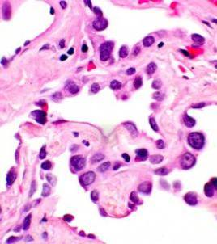
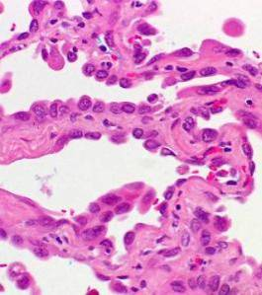
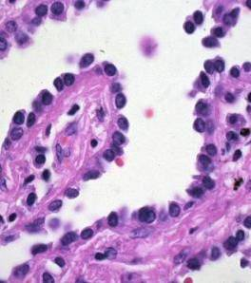
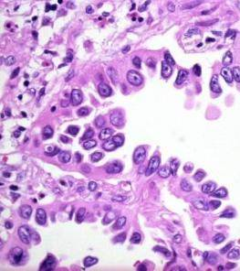
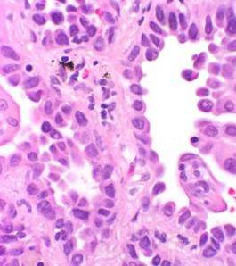
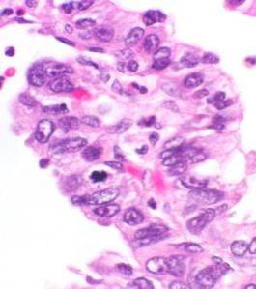
AAH
AIS

Slide 16
Adenocarcinoma in Situ/AIS
Pure lepidic growth < 3 cm
100% disease free survival
Diagnosis cannot be made on cytologic or biopsy specimens
Very rare in mucinous tumors

Slide 17
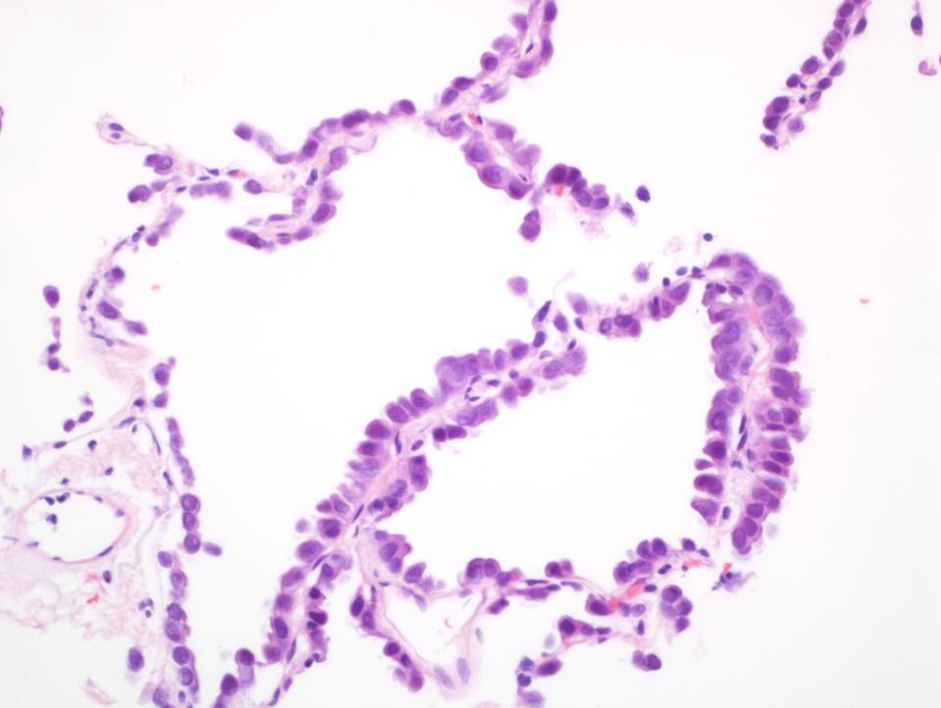
Lepidic growth pattern

Slide 18

Lepidic growth pattern

Slide 19
Whence Lepidic?
Neologism of Dr. John Adami in 1902 at the Toronto Pathological Society
Term applied to tumors that appeared to be derived from surface lining cells (as opposed to hylic (from connective tissue)
Jones, KD Arch Pathol Lab Med 2013;137:1822-24

Slide 20
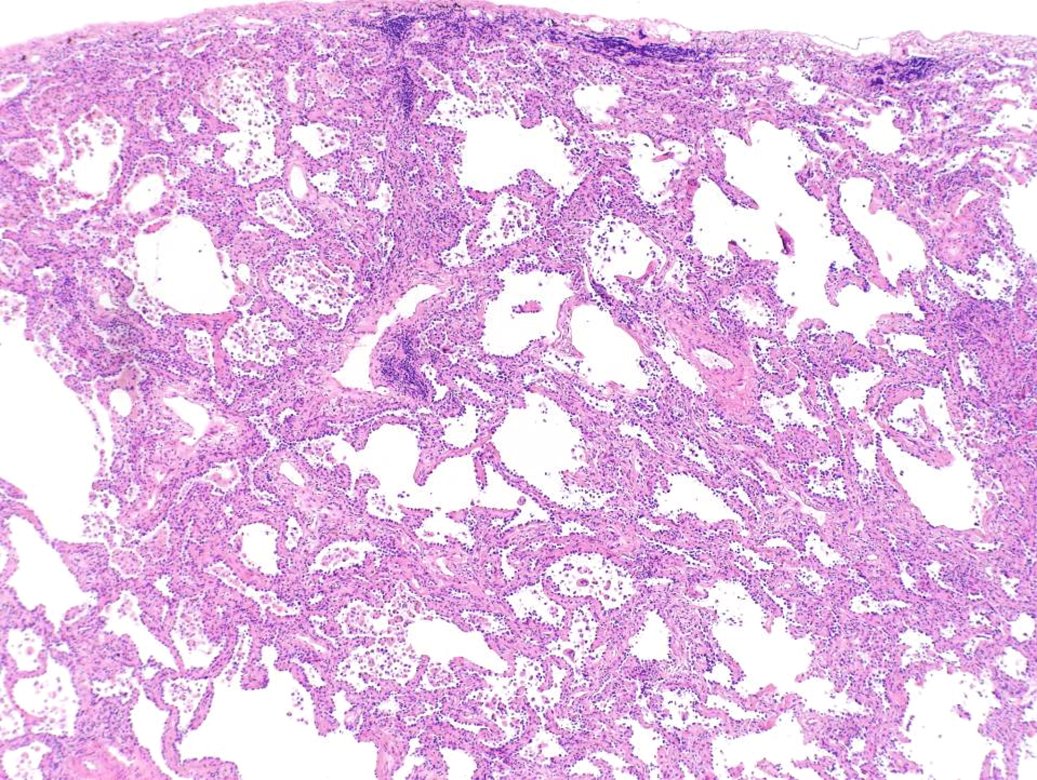
AIS

Slide 21
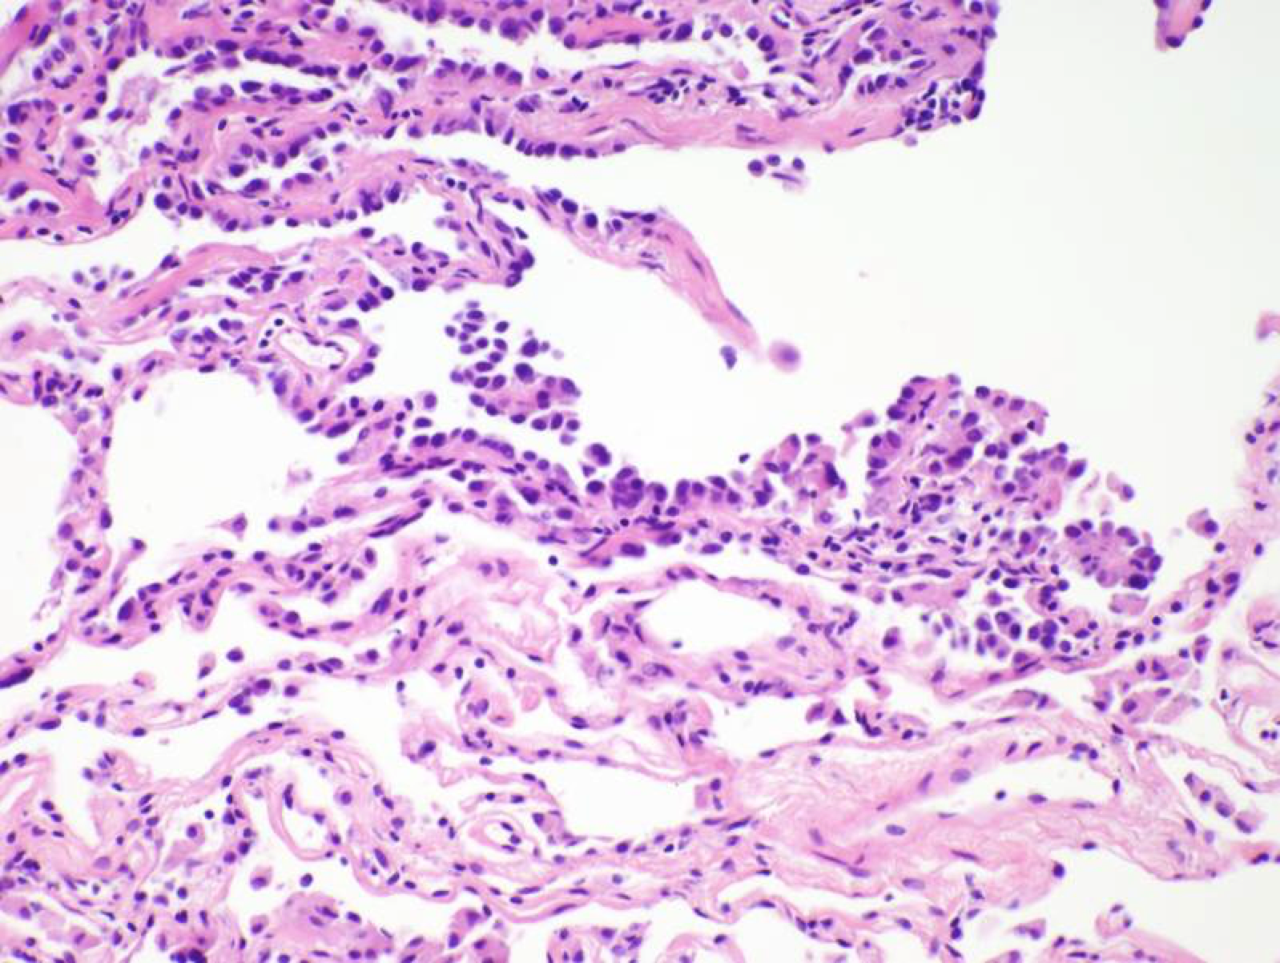
AIS

Slide 22
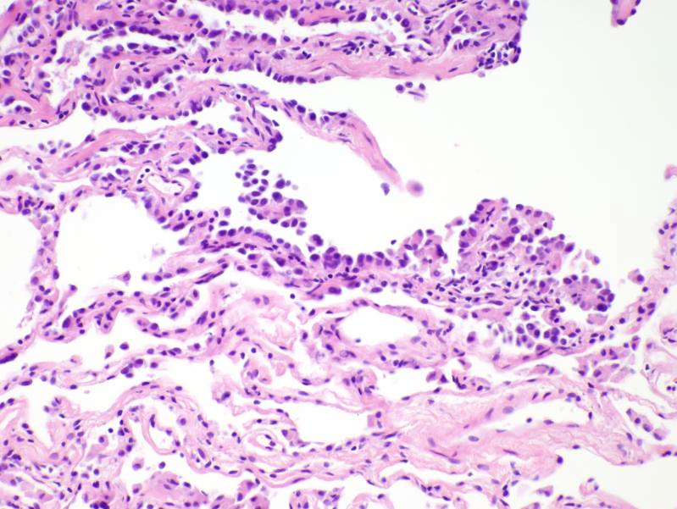
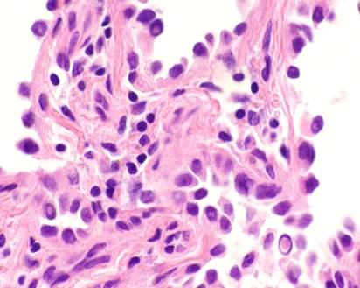
AIS

Slide 23
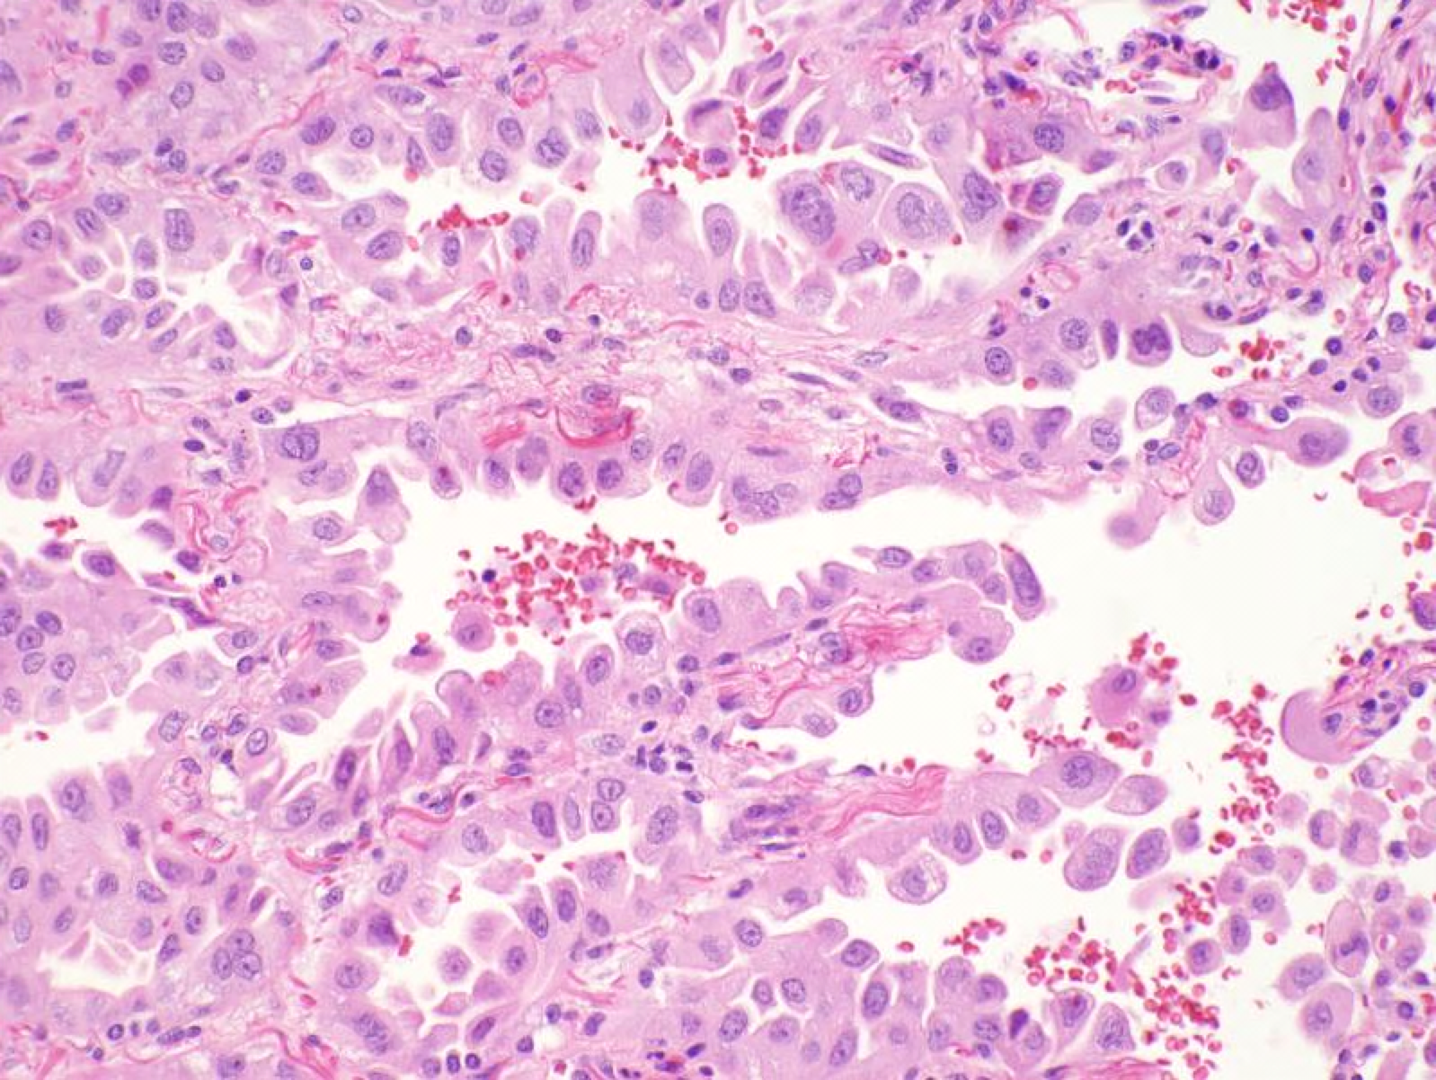
AIS

Slide 24
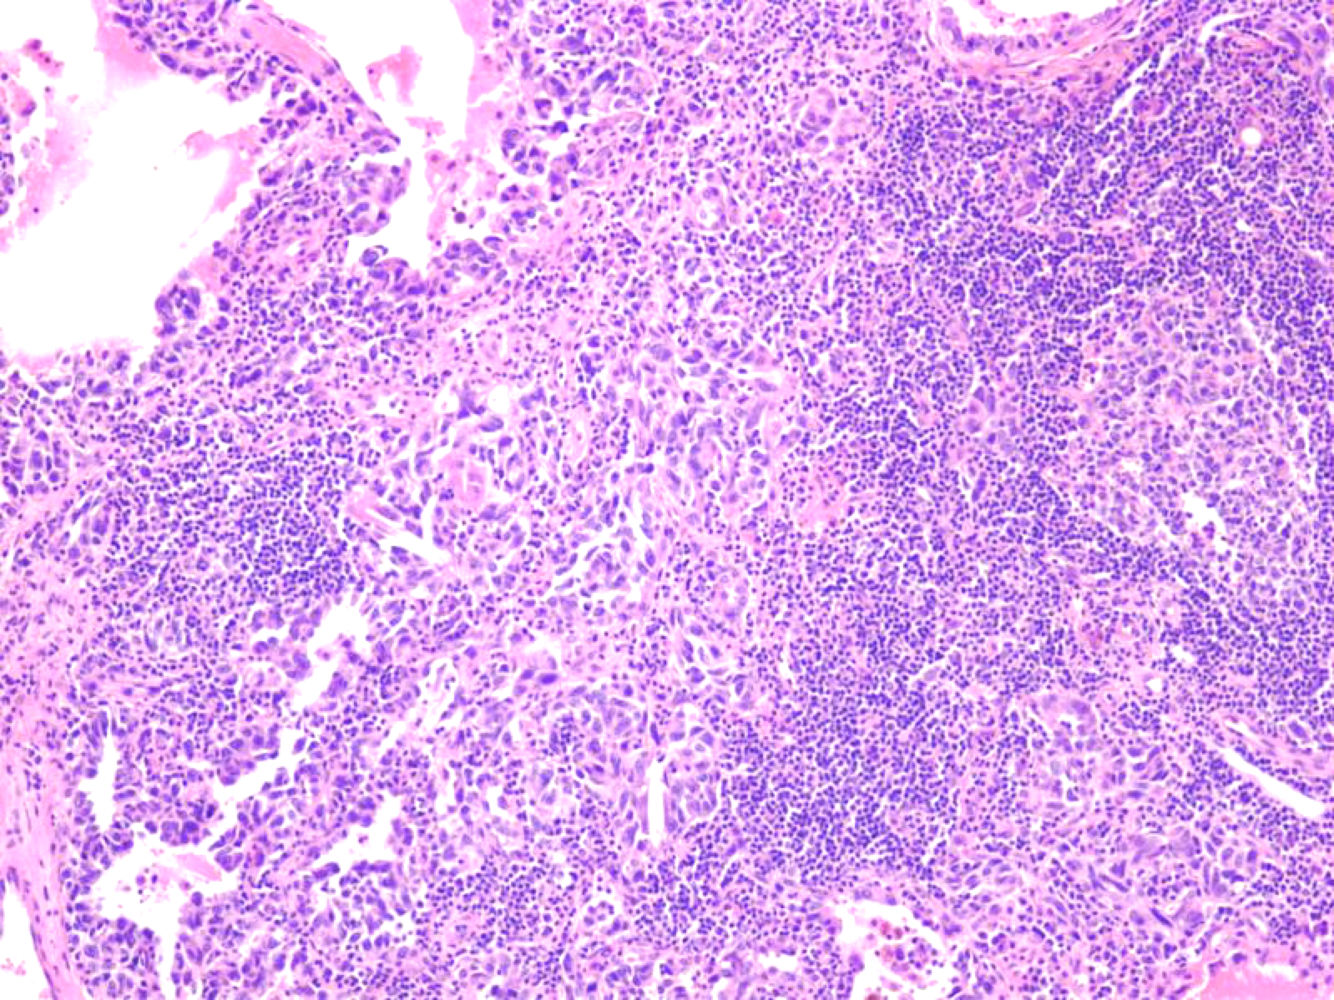
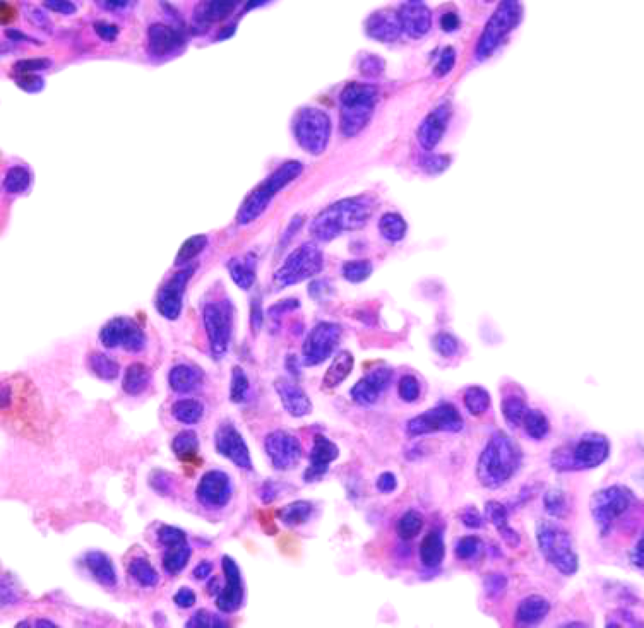
AIS with Lymphoid Infiltrate

Slide 25
Minimally Invasive Adeno (MIA)
Lepidic growth, < 3 cm, < 5 mm of invasion
If multiple areas of micro- invasion present, the largest area focus should be < 5 mm (do not add foci)
  Estimate % invasive and multiply by tumor size
No necrosis, lymphovascular or pleural invasion

Slide 26
Defining Invasion
Does not equate with alveolar collapse/ septal widening or sclerosis
Requires
  Angulated glands or single cells infiltrating stroma with stromal desmoplasia
  Destruction of elastica (VVG, laminin)
  Presence of histologic type other than lepidic pattern e.g. acinar, micropapillary

Slide 27
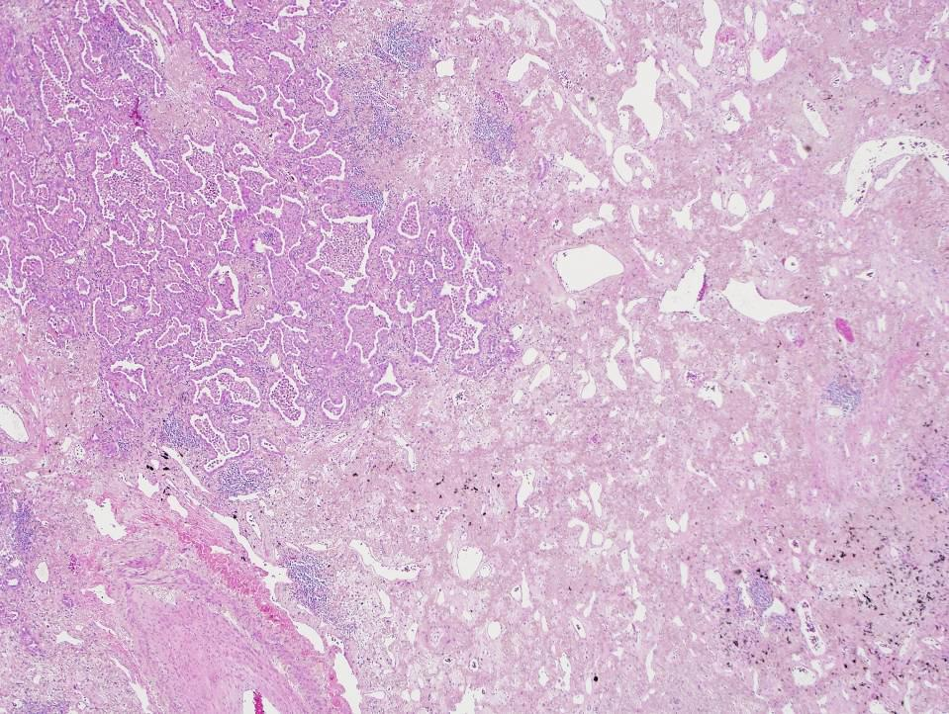
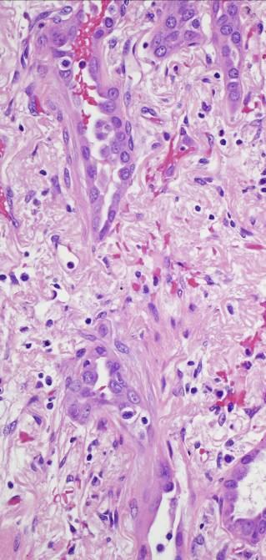
Angulated glands
as invasion < 5 mm

Slide 28
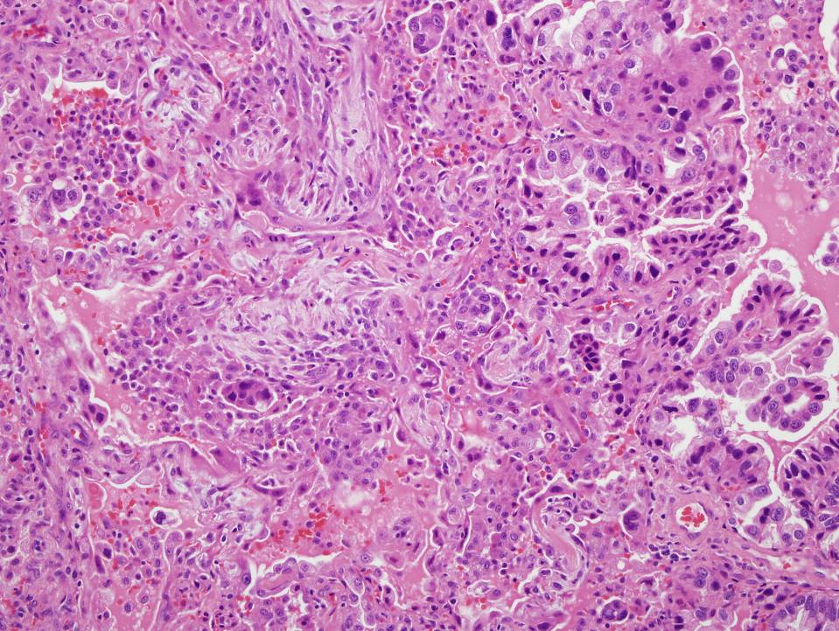
Sm cell groups and papillae as invasion

Slide 29
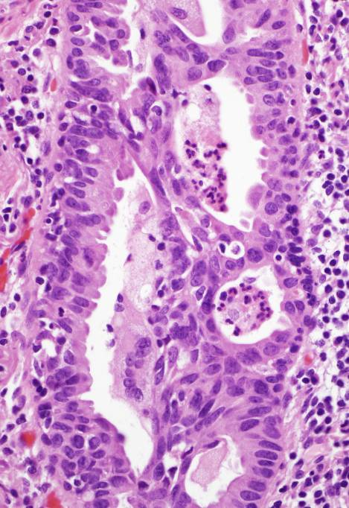
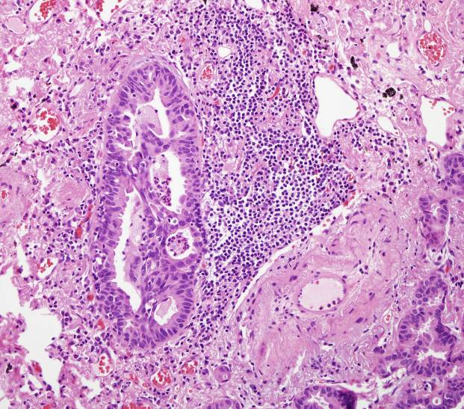
Acinar pattern as invasion

Slide 30
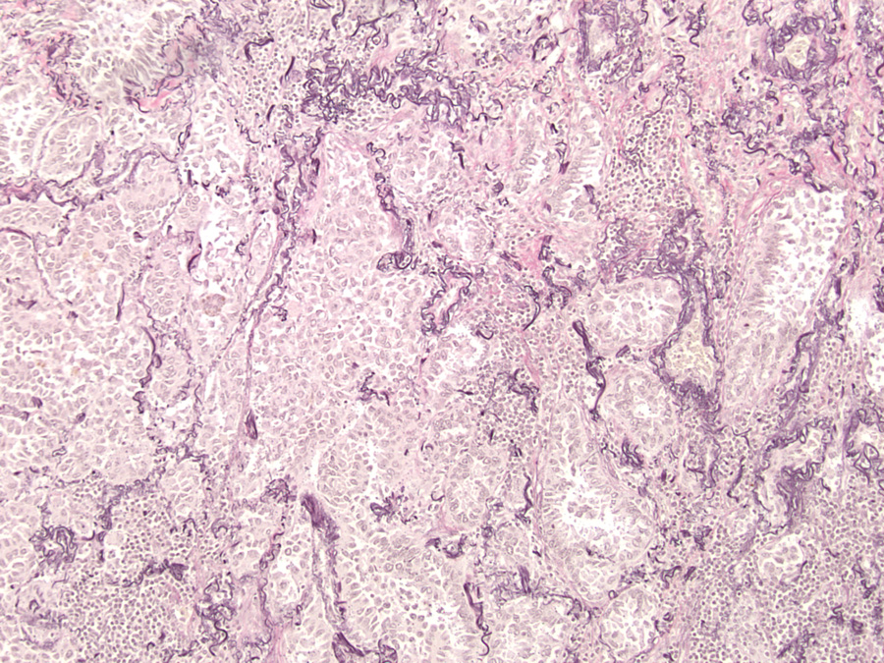
Loss of elastica in invasive adca

Slide 31
Minimally Invasive
Adenocarcinoma
Dx cannot be established w/o sampling entire tumor
Insufficient data on tumors > 3 cm
For resected tumors > 3 cm suspected to be AIS or MIA: “Lepidic predominant adca, suspect AIS or MIA”

Slide 32
Major Adenocarcinoma Subtypes
Lepidic
Acinar
Papillary
Micropapillary
Solid

Slide 33
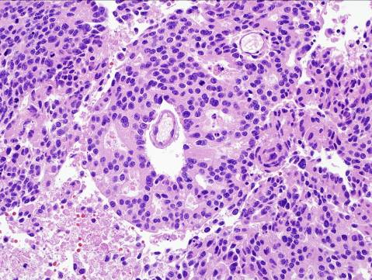
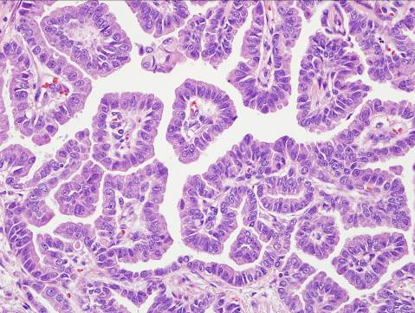
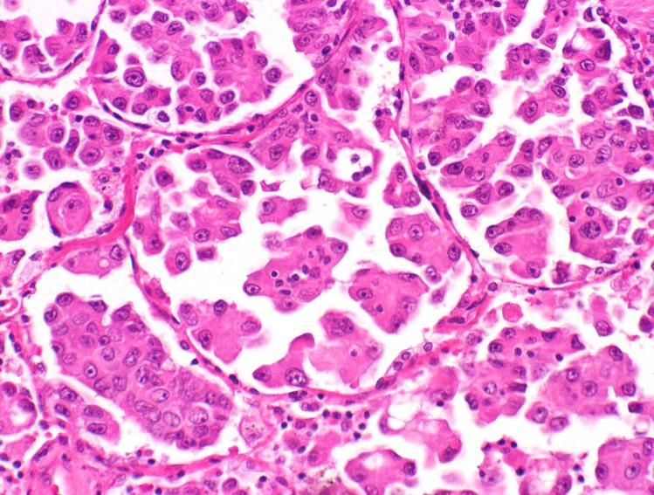
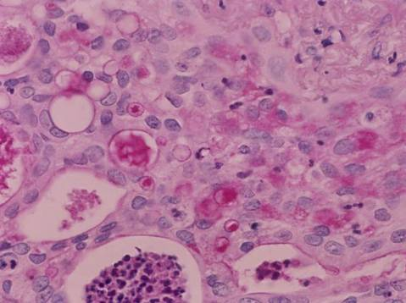
Acinar
Papillary
Micropapillary
Solid
Notes:
Major subtypes

Slide 34
Lepidic Predominant
Adenocarcinoma
Non mucinous histology
Lepidic growth in majority of tumor
Invasion > 5 mm in at least one focus
Lymphatic, vascular, or pleural invasion may be present
Necrosis may be present

Slide 35
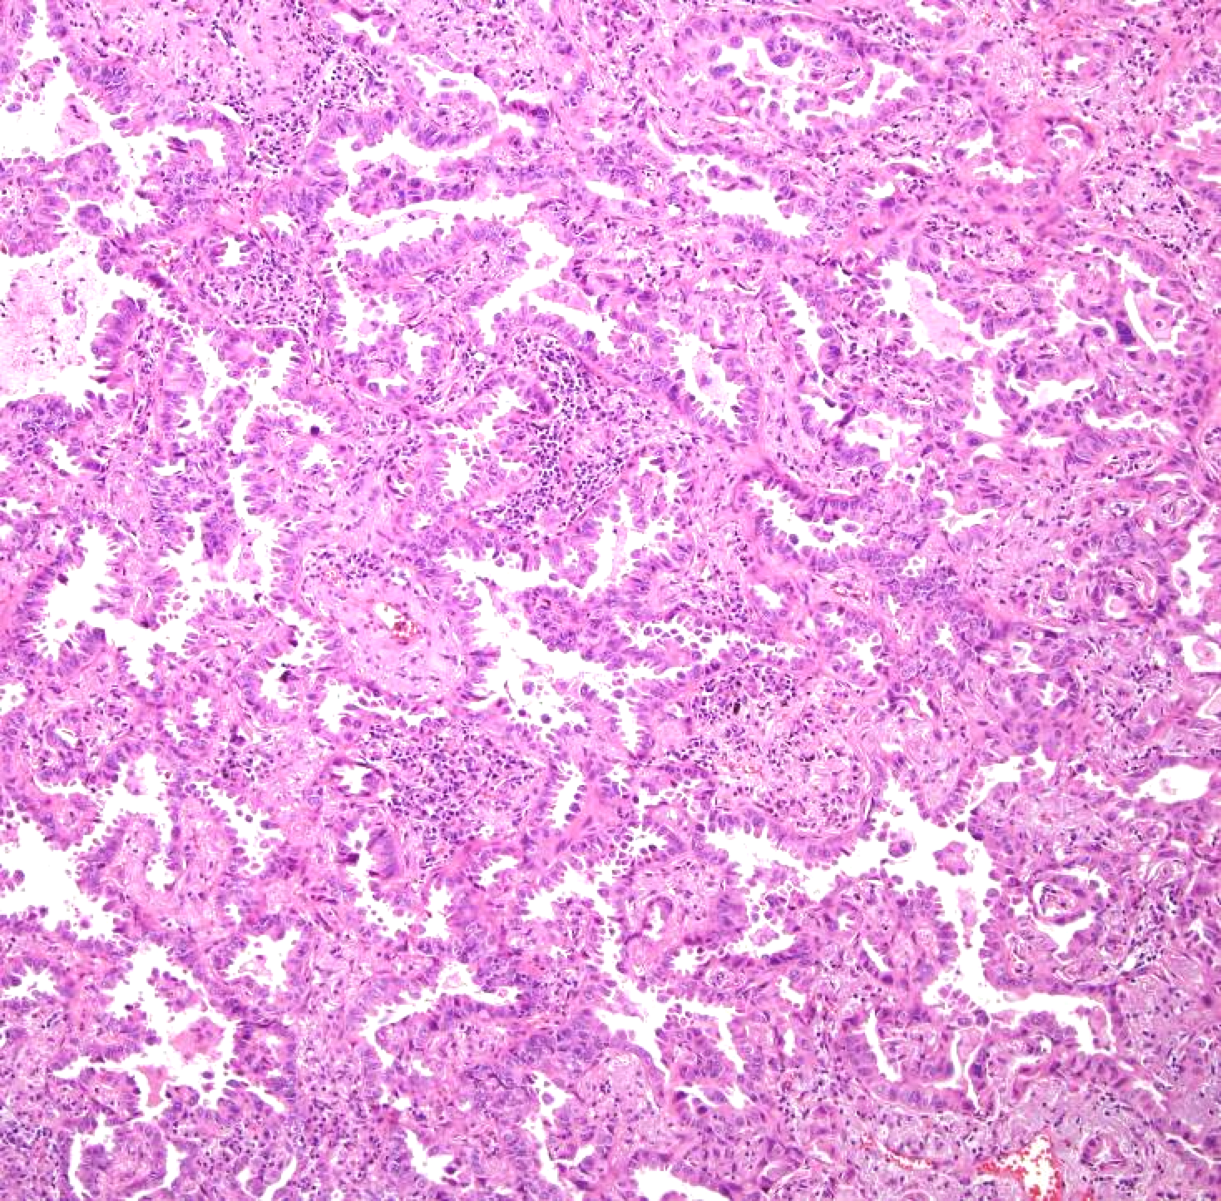
LPA

Slide 36
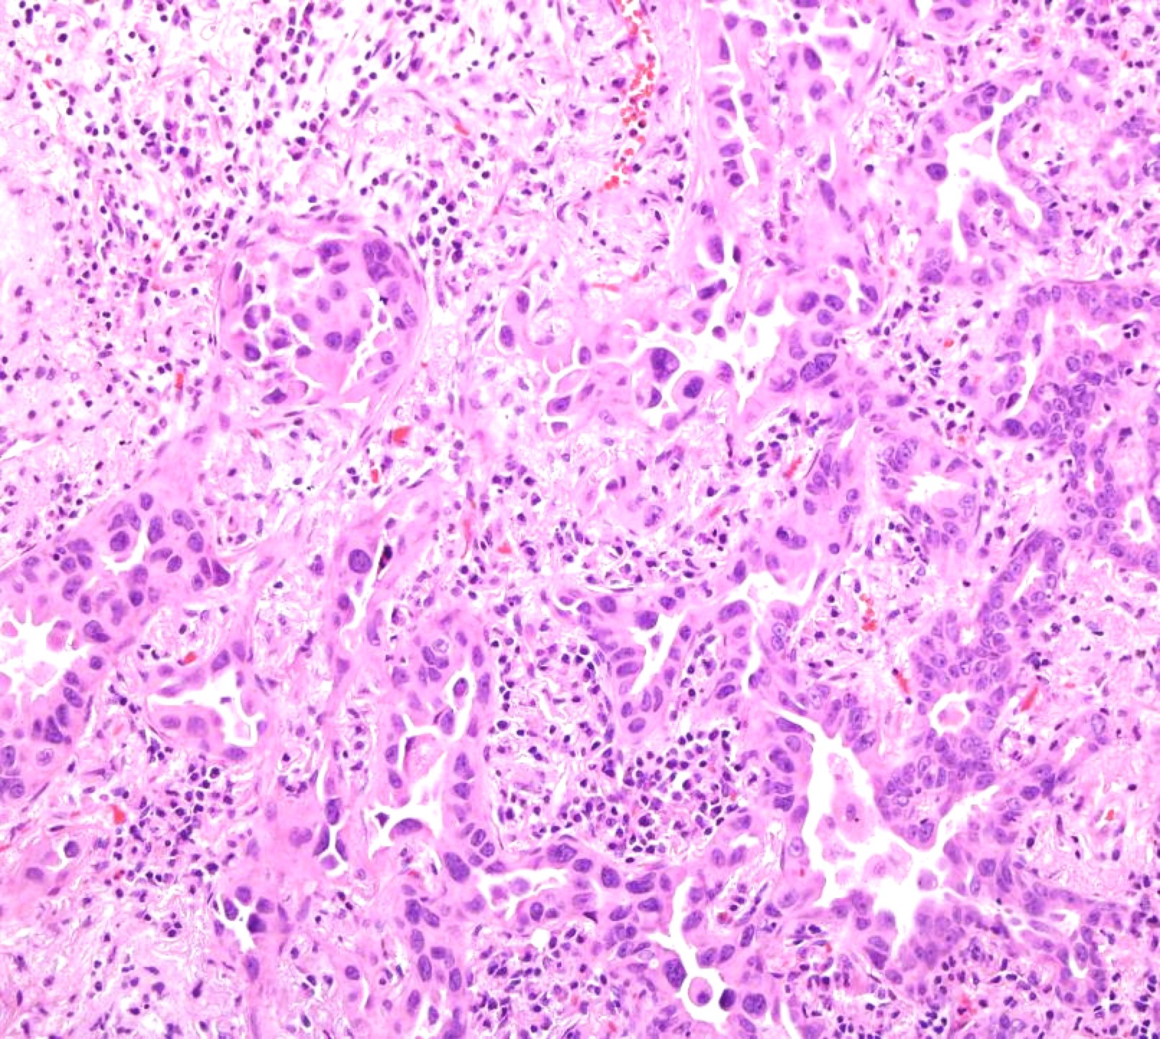
LPA

Slide 37
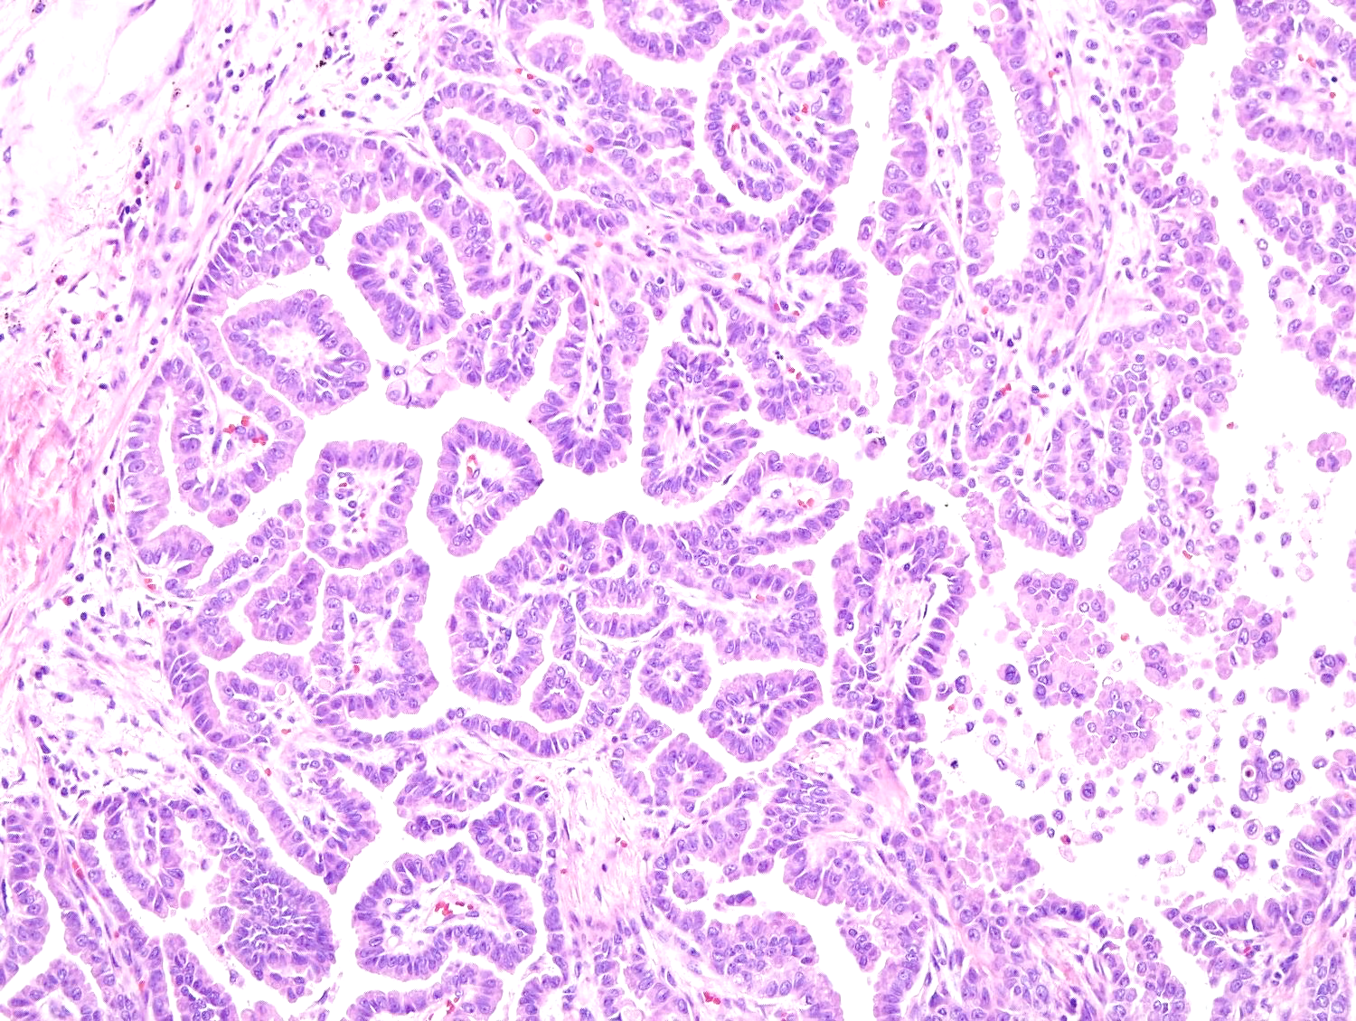
Papillary
Not AIS- too complex

Slide 38
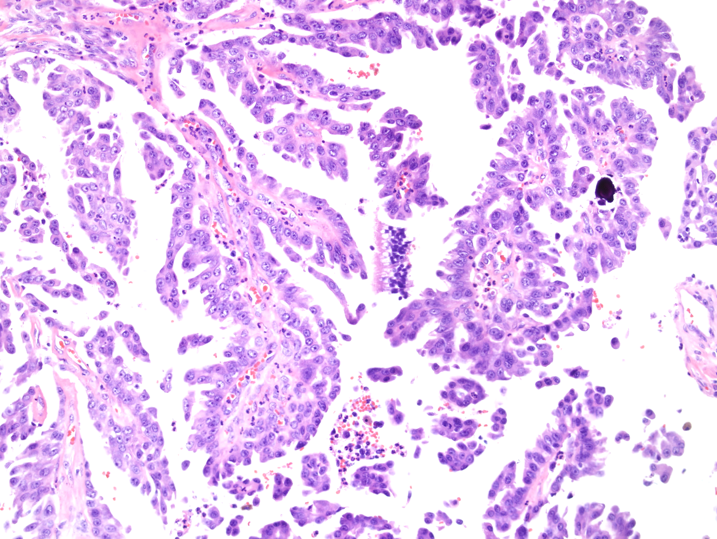
Papillary

Slide 39
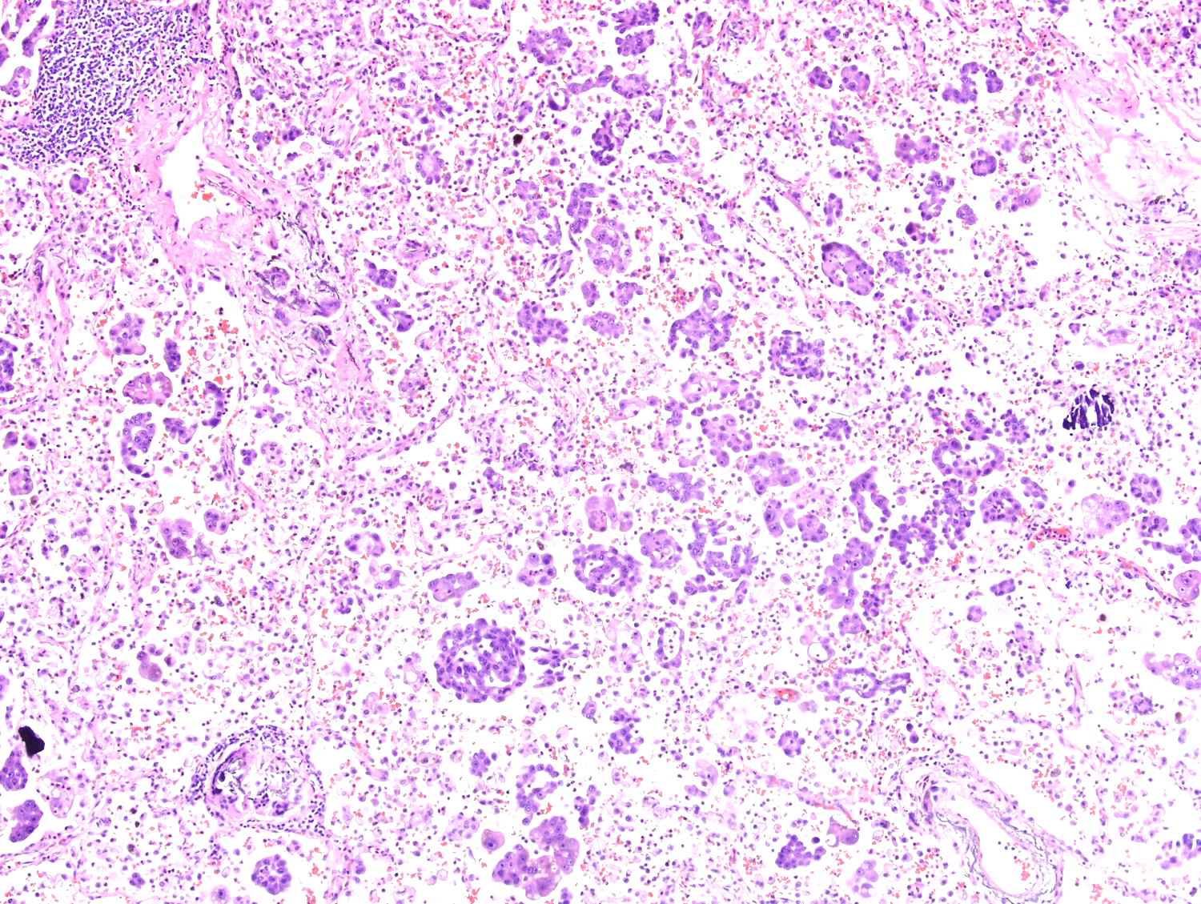
Micropapillary

Slide 40
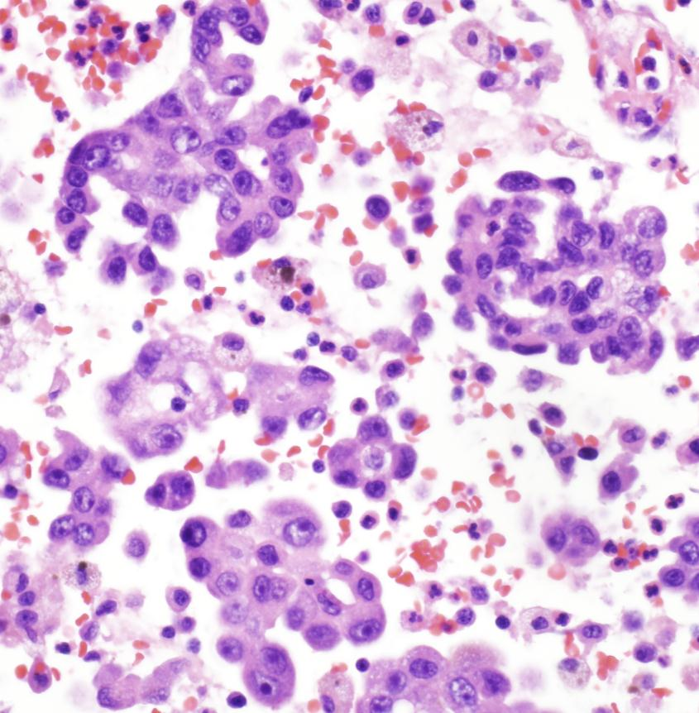
Micropapillary

Slide 41
Criteria for Micropapillary
Epithelial nest anastomosis /confluence
Multiple nests in same alv. space
Small/medium tumor nest size ( 1-12 cells)
Intracytoplasmic vacuoles
Monroig-Bosque PC et al. Mod Pathol 2018 31(S2):741

Slide 42
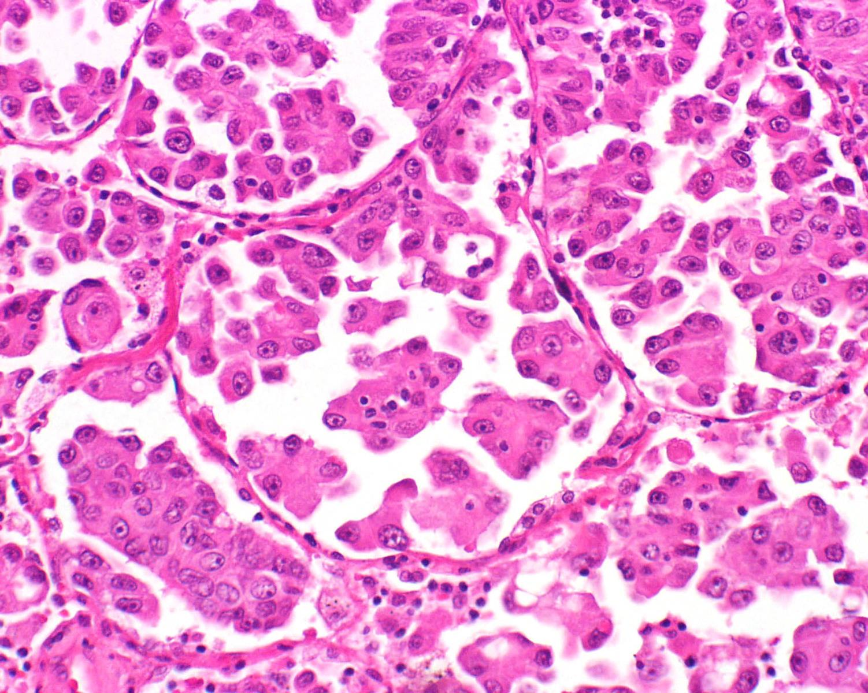
Micropapillary

Slide 43
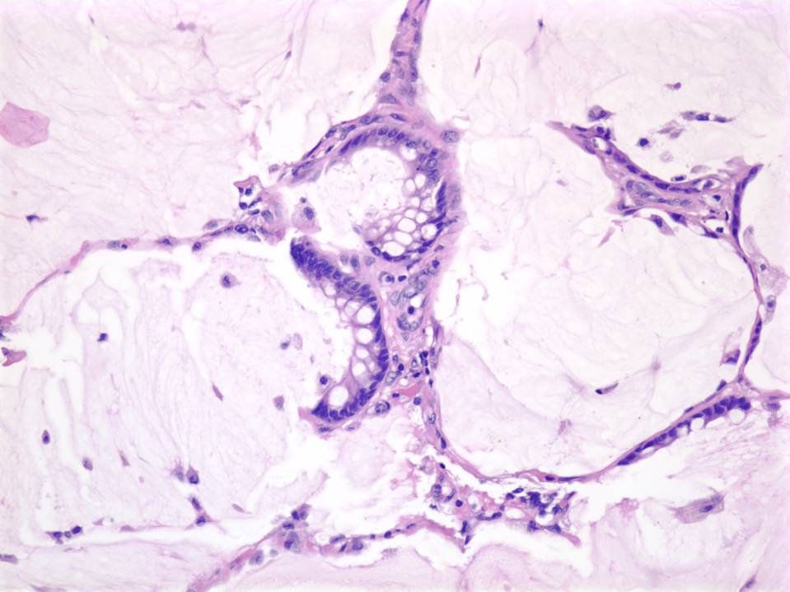
Colloid Variant

Slide 44
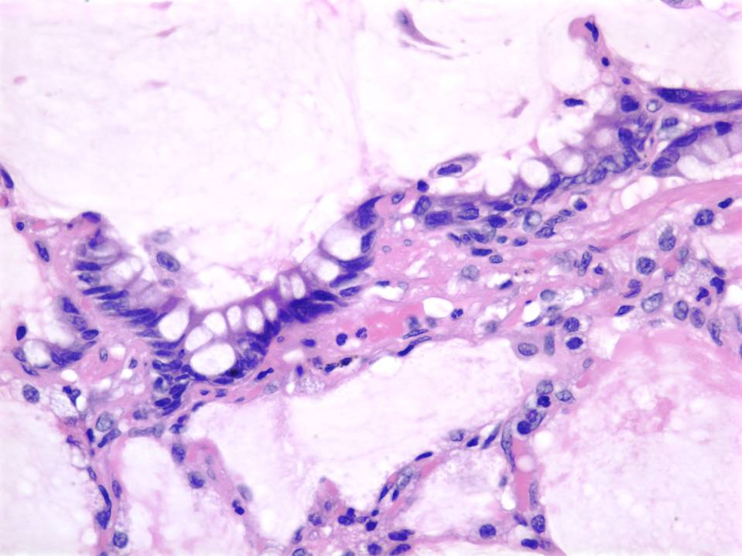
Colloid Carcinoma with
floating malignant cells
Notes:
TV 89-93

Slide 45
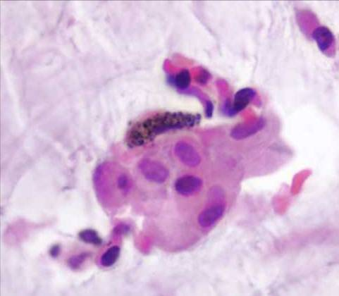
Colloid Carcinoma with
floating malignant cells
Notes:
TV 89-93

Slide 46
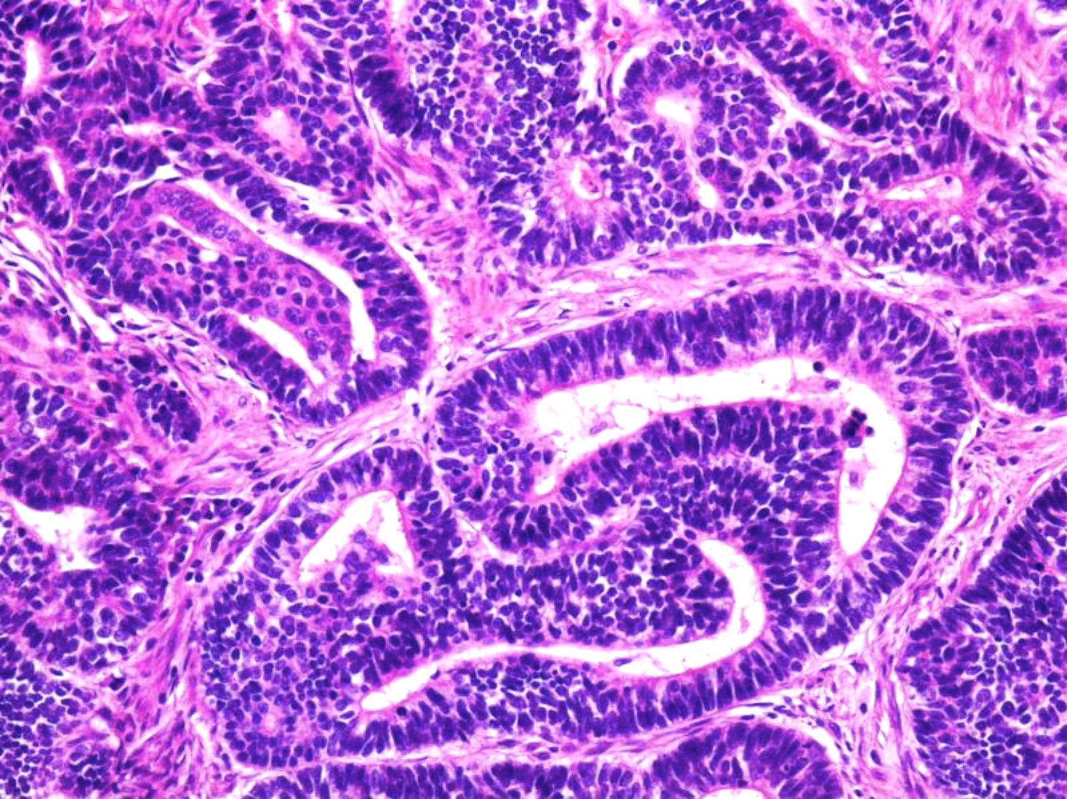
Fetal Variant
Glands appear “endometrioid”

Slide 47
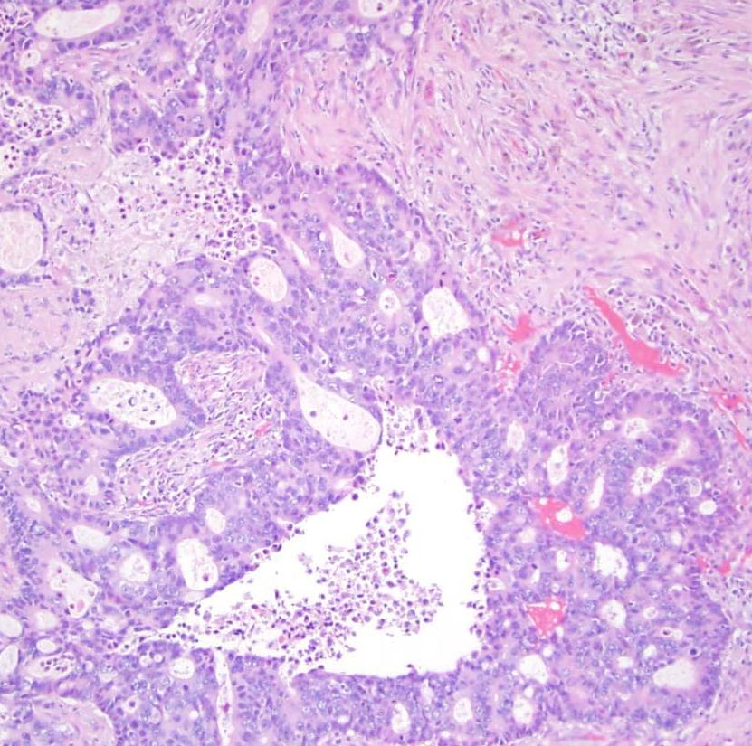
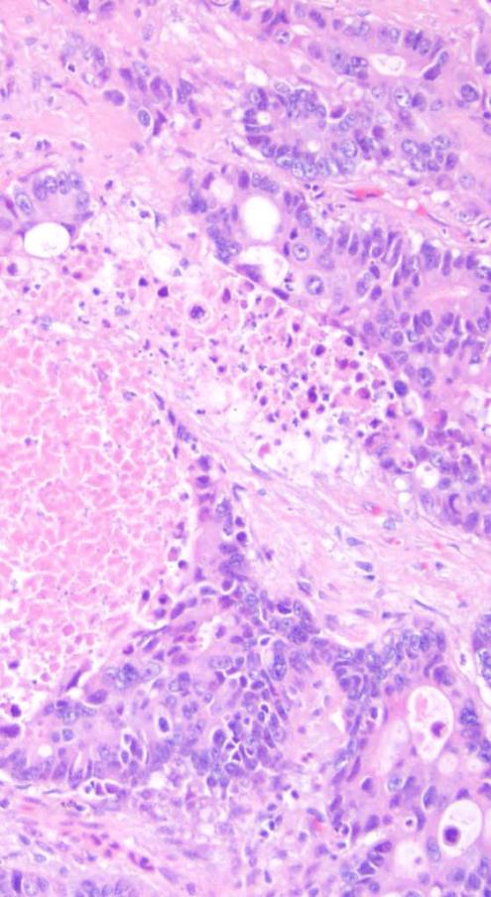
Enteric Variant
Courtesy of Dr. Lindsay Schmidt, Ann Arbor, MI

Slide 48
Small Biopsy and
Cytology Diagnosis
On small biopsies and cytology specimens, sub-classification is recommended whenever possible e.g. squamous, adca

Slide 49
Randomized Phase II Trial Comparing
Bevacizumab* plus Carboplatin and
Paclitaxel with
Carboplatin and Paclitaxel Alone in Previously Untreated Locally Advanced or Metastatic Non-small Cell Lung Cancer
Johnson DH et al J Clin Oncol
2004; 22:2184-2191
*recombinant humanized version
of murine anti human VEGF MoAb

Slide 50
Results
Treatment group: Higher response rate, modest increase in survival
Of concern, however, was the occurrence of six life-threatening pulmonary hemorrhages…
…were more frequent with squamous carcinomas …compared with adenocarcinomas
Johnson DH et al J Clin Oncol
2004; 22:2184-2191

Slide 51

…the Update Committee recommends the addition of bevacizumab, except for patients with squamous cell carcinoma histologic type…

Slide 52
“ The ability to rule out squamous histology in a patient with NSCLC would allow an oncologist to consider drugs that may lower the patient’s risk of death by 20% to 30%, which may improve median survival time by approximately 2 months.”

Slide 53
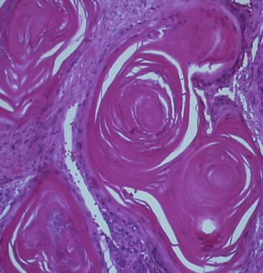
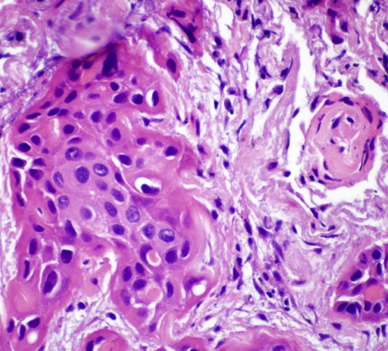
Squamous Carcinoma
Malignant epithelial tumor showing,
Keratinization
&/or
Intercellular bridges

Slide 54

Guidelines for Diagnosis
Look for desmosomes, mucin or glands. If absent…

Slide 55
WHO Recommendation for
Small Biopsies and Cytology
Perform limited IHC panel
  TTF-1
  p40
Conserve tissue for potential molecular testing
  Split samples into multiple blocks

Slide 56
Small Biopsy and
Cytology Diagnosis
Diagnostic categories when clear differentiation absent
  NSCLC, favor Adca (+ TTF regardless of other markers)
  NSCLC, favor Sqca (+ and – markers all favor)
  NSCLC NOS – diagnose sparingly

Slide 57
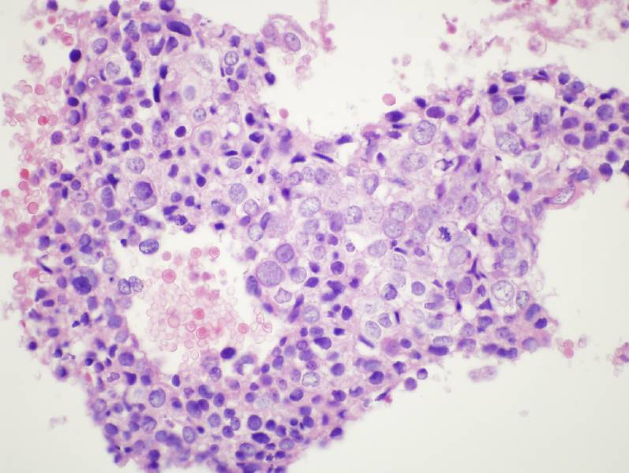

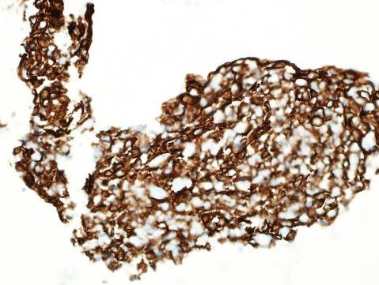
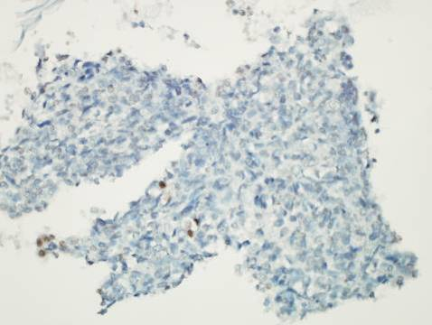
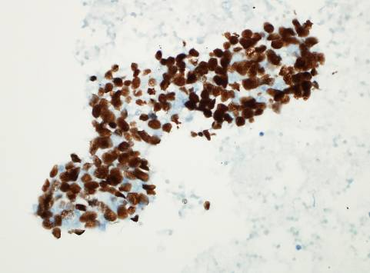
NSCLC, Favor Squamous Carcinoma
CK 5/6
TTF-1
p40

Slide 58
Additional Caveats
Adca may appear pseudosquamous
Densely eosinophilic cytoplasm or sharp intercytoplasmic borders in the absence of frank keratinization, pearls or intercellular bridges is insufficient for squamous cell
Many EGFR mutated cases of squamous carcinoma, likely represent adenosquamous ca or pseudosquamous ca

Slide 59
Predominant Pattern
Grade
AIS/MIA
Lepidic
Papillary
Acinar
Mucinous
Colloid
Solid
Micropapillary
Low
Intermediate
High
Sica G. et al. Am J Surg Pathol 2010;34:1155–1162

Slide 60
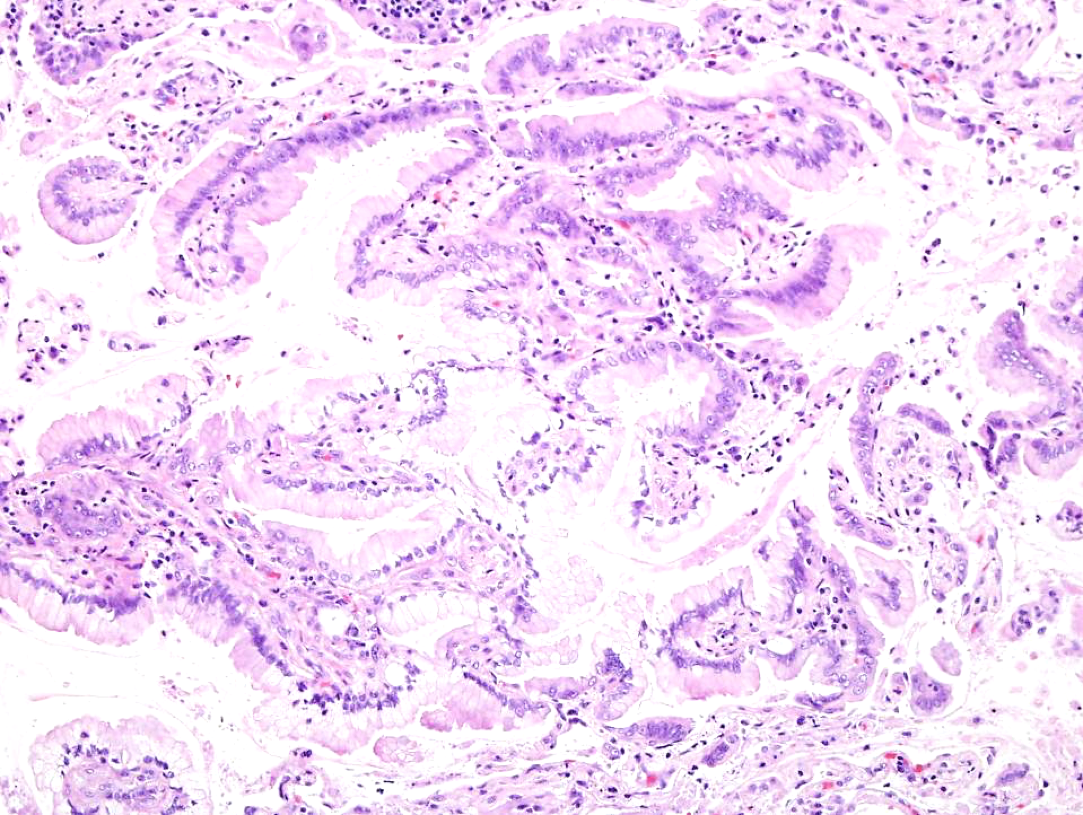
Mucinous

Slide 61
Diagnosis of ADCA on Needle or
Transbronchial Biopsy
What features suggest adca?
  Large cell size
  Monotony of cell population
  Subtle nuclear pleomorphism
  Uniform population of mucinous cells
  Lack of cilia

Slide 62
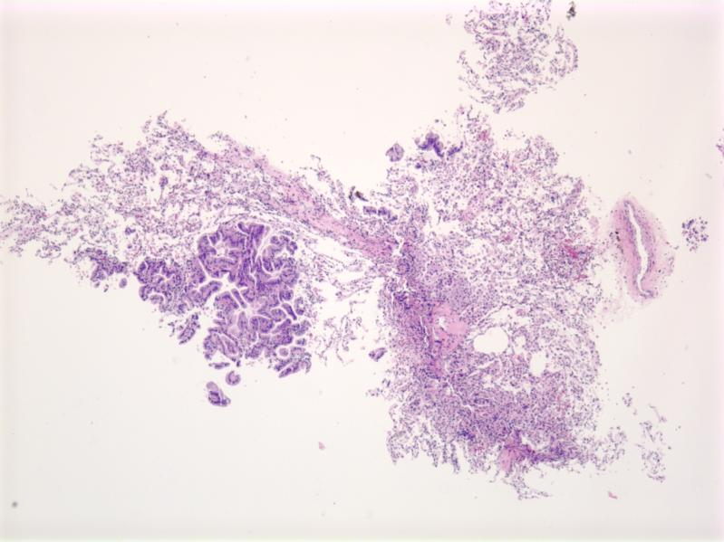
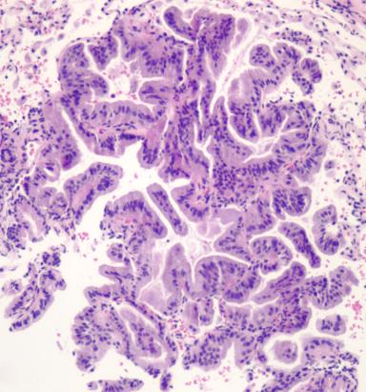

Slide 63
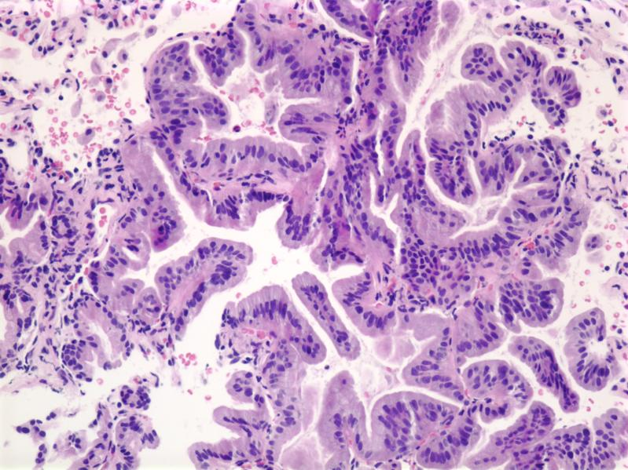

Slide 64


Slide 65


Slide 66


Slide 67


Slide 68


Slide 69


Slide 70


Slide 71

Pan keratin

Slide 72

TTF-1

Slide 73

Sclerosing Pneumocytoma
(original dx: adenocarcinoma)
EMA

Slide 74
AJCC 8th Edition:
Guiding Principles
  Large retrospective data set: 70,967 NSCLC and 6,189 SCLC
  Data limited for sub-solid and multiple lung cancers
  Clinical and pathology T,N,M match
  Radiologic info necessary for pT

Slide 75
7th ed.
8th ed.
T0 No primary tumor
Tis CIS
T1 ≤ 3 cm not in main bronchus and no pleural invasion
T1a ≤ 2 cm
T1b > 2 < 3 cm
T0 No primary
Tis CIS (SCIS-AIS)
Tmi < 5 mm
T1 ≤ 3cm not in main bronchus and no pl. invasion
T1a ≤ 1 cm
T1b > 1 ≤2 cm
T1c > 2 ≤ 3cm

Slide 76

Measure the Gross if at all possible
~ 10% shrinkage

Slide 77

Part Solid (presumed invasive),
Part GG (presumed lepidic)

Slide 78


Slide 79




Stage on invasive, mention both sizes
Lepidic
Acinar

Slide 80



Part Solid, Part GG
Wedge
7 mm
9 mm
16 mm
Lobectomy

Slide 81
7th ed.
8th ed.
T2 > 3 ≤ 7 cm OR w/ any of:
pleural invasion, main bronchus ≥ 2 cm from carina, atelectasis/obst. pneumonia to hilum
T2a > 3cm ≤ 5cm
T2b > 5cm ≤ 7cm
T2 > 3 ≤ 5 cm OR w/ any of:
pleural invasion, main bronchus, atelectasis/obst. pneumonia to hilum, part or all of lung
T2a > 3 cm ≤ 4 cm
T2b > 4 cm ≤ 5 cm

Slide 82


T2 due to atelectasis or obstructive pneumonia that extends to the hilar region, involving all or part of the lung

Slide 83
7th ed.
8th ed.
T3 > 7cm OR invasion into par. pl. or pericard, diaph., chest wall, mediastinal pl, in main bronchus < 2cm from carina, atelectasis/obstructive pneumonia of entire lu or separate tumor nodule same lobe
T3 > 5cm ≤ 7cm OR invasion into parietal pleura or pericardium, chest wall, or separate tumor nodule in same lobe

Slide 84
7th ed.
8th ed.
T4 any size with invasion of heart, trachea, esophagus, vertebra or separate tumor nodule in
other ipsilat lobe
T4 > 7cm or any size with invasion of diaphragm, heart, trachea, esophagus, vertebra or separate tumor nodule in other ipsilat lobe

Slide 85
7th ed.
8th ed.
T4 any size with invasion of heart, trachea, esophagus, vertebra or separate tumor nodule in
other ipsilat lobe
T4 > 7cm or any size with invasion of diaphragm, heart, trachea, esophagus, vertebra or separate tumor nodule in other ipsilat lobe

Slide 86
8th ed. Nodal Status
N0 No regional LN met
N1 Met in ipsilateral peribronchial and/or hilar LN and intrapulmonary LN including direct extension
N2 Met in ipsilateral mediastinal and/or subcarinal LN
N3 Met in contralateral hilar or mediastinal, ipsilateral or contralateral scalene or supraclavicular LN

Slide 87
7th ed.
8th ed.
M0 No distant mets
M1 Distant mets
M1a Separate tumor nodule (s) in contralateral lu, tumor with pl nodule(s) or malignant pl effusion
M1b Distant mets
M0 No distant mets
M1 Distant metastasis
M1a Any of: pl.
/pericard effusion, or pl pericard nodule(s), contralateral/bilateral nodule (s), > 1 of above
M1b Single met in single organ
M1c Multiple mets in single or multiple organs

Slide 88


Staging of Multiple Tumors
First need to determine if the tumor nodules are separate primaries or intrapulmonary metastasis

Slide 89
Multiple Lung Carcinomas
3 different clinical scenarios with 3 different staging schemes
  Multiple solid tumor nodules
  Multiple nodules with ground glass or lepidic features
  Pneumonic involvement

Slide 90
Clinical criteria*no comprehensive histologic assessment
May be considered separate primary tumors
Clearly different histologic types (ie SQCC and AD)
May be considered intrapulmonary metastasis
Exactly matching breakpoints on CGH
Relative arguments to favor separate primary tumors (consider with clinical factors)
Different radiographic appearance or metabolic update
Different patterns of biomarkers
Different rates of growth
Absence of nodal or systemic metastasis
Relative arguments to favor intrapulmonary metastasis
Same radiographic appearance
Similar growth pattern
Significant nodal or systemic metastases
Same biomarker pattern (and same histotype)

Slide 91
Pathologic criteria* requires resection
May be considered separate primary tumors
Clearly different histologic types (ie SQCC and AD)
Clearly different with comprehensive histologic assessment
SQCC arising from CIS
May be considered intrapulmonary metastasis
Exactly matching breakpoints on CGH
Relative arguments to favor separate primary tumors (consider with clinical factors)
Different patterns of biomarkers (molecular signature)
Absence of nodal or systemic metastasis
Relative arguments to favor intrapulmonary metastasis
Matching appearance of comprehensive histologic assessment
The same biomarker pattern
Significant nodal or systemic metastases

Slide 92
Comprehensive Assessment
  Histologic subtype
    AD, SQCC, SCLC, Sarcomatoid….
  Relative proportion of AD patterns -5% increments
    Acinar, papillary, lepidic, solid…
  Grade
  Cytologic and stromal features
  No interobserver comparison
  Girard et al Am. J Surg Pathol 2009; 33:1752-64

Slide 93


RUL
Comprehensive Histologic
Assessment
RML

Slide 94
Case | Tumor 1 | Tumor 2 | Prediction
Case 1 Reviewer 1 | AD Cribriform 80% Acinar 10% Solid 10% | AD Acinar 50% Lepidic 40% Papillary 10% | Independent 1aries
Case 1 Reviewer 2 | AD Solid 50% Cribriform 50% | AD Papillary 40% Acinar 30% Lepidic 10% Cribriform 10% Solid 10% | Independent 1aries
Case 2 Reviewer 1 | AD Acinar 70% Lepidic 30% | MIA | Independent 1aries
Case 2 Reviewer 2 | AD Acinar 50% Papillary 50% | AD Lepidic 70% Acinar 30% | Independent 1aries
Case 3 Reviewer 1 | AD Solid 45% Acinar 35% Lepidic 20% | AD Acinar 70% Lepidic 20% Solid 10% | Independent 1aries
Case 3 Reviewer 2 | AD Acinar 50% Solid 20% Lepidic 20% Cribriform 10% | AD Acinar 40% Lepidic 30% Solid 20% Papillary 10% | Metastasis
Murphy et al JCO 2014; 32:4050

Slide 95
Reproducibility in
Determining Lineage
Agreement on predominant pattern in 12/16 (75%)
When in doubt, share
NGS breakpoints- able to accurately classify tumors predicted to be independent primaries or metastases.
Murphy et al JCO 2014; 32:4050

Slide 96
Molecular Profiling Summary
CGH recommended
NGS
  Same mutations can be present in different tumor types
  Correlation with histology key
Dacic S Arch Pathol Lab Med 2017:923-6

Slide 97
Interobserver Variation Among
Pathologists Using
Comprehensive Subtyping
126 tumors from 48 pts
Classified by 17 pulmonary pathologists
Kappa = 0.6 for second primary vs intrapulmonary mets
Predominant type, nuclear pleomorphism, cell size, acinar formation, nucleolar size, mitotic rate
Nicholson AG et al. Histopathology JTO 2018; 205-217

Slide 98
Multiple Tumors
If independent primaries
  Stage each tumor separately according to its features
If considered metastasis
  No changes from prior edition
  T3 Same lobe nodule
  T4 Same-side different lobe nodule
  M1a Contralateral nodule

Slide 99

T4 Cancer- if same histology
1º superior segment RLL
Tumor nodule RUL-met

Slide 100

Multiple Ground Glass or Lepidic
Predominant Tumors (non-mucinous)
Stage the largest
Add m modifier

Slide 101


Slide 102

Diffuse Pneumonic
(Typically with mucinous component)
One Lobe:size or T3
Multiple ipsl lobes T4
Bilateral: M1a

Slide 103
…A long way from Liebow
No more BAC
AIS and MIA
Doing less, and more, with less
Importance of comprehensive assessment and predominant subtypes
8th Edition clarifies a number of complex issues…but…

Slide 104

Thank you

